Slide 1
Rainwater harvesting and greywater re-use
PowerPoint presentation
Unit 301: Understand the fundamental principles and requirements of environmental technology systems

Slide 2
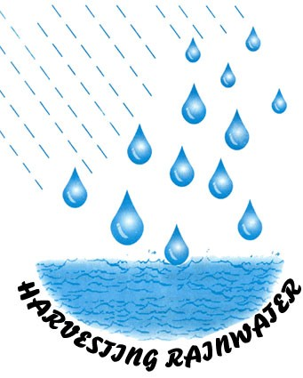
Rainwater harvesting
The UK practice of using mains water to supply all our water needs is needlessly wasteful, both financially and environmentally.
Mains water is expensively purified to drinking water standards – but much of the water is used for non-potable purposes, like flushing toilets, cleaning and gardening.
Harvested rainwater can be substituted for mains water, saving money and contributing to the protection of a key natural resource.

Slide 3
Rainwater harvesting
Rainwater harvesting (RWH) is a practice of growing importance in the UK, particularly in the South East of England where there is less water available per person than in many Mediterranean countries.
Rainwater harvesting in the UK is both a traditional and reviving technique for collecting water for domestic uses.
This water is generally used for non-hygienic purposes like watering gardens, flushing toilets, and washing clothes.

Slide 4
Rainwater harvesting
There is a growing demand for larger tank systems collecting between 1,000–7,500 litres of water.
The two main uses for harvested rainwater are botanical uses, like gardening for plant irrigation, and domestic uses, like flushing toilets and running washing machines.

Slide 5
Rainwater harvesting
Rainwater is almost always collected strictly from the roof, then heavily filtered using either a filter attached to the down pipe, a fine basket filter or for more expensive systems like self-cleaning filters placed in an underground tank.
The velodrome of the London Olympic Park is designed to harvest rainwater.

Slide 6
Rainwater harvesting
There are three types of rainwater systems available:
Gravity (non-pressurised): Collected rainwater is pumped from the main holding tank to an elevated/header tank. The connected appliances are then supplied from the tank as in a normal gravity fed system.
Direct (pressurised): Collected rainwater is pump-fed direct from the main holding tank to the serviced appliances.
Combination: Collected rainwater is pumped or gravity-fed to a low level break tank. In turn the water is then gravity-fed to an integral or external booster pump system for onward distribution to the serviced appliances.

Slide 7
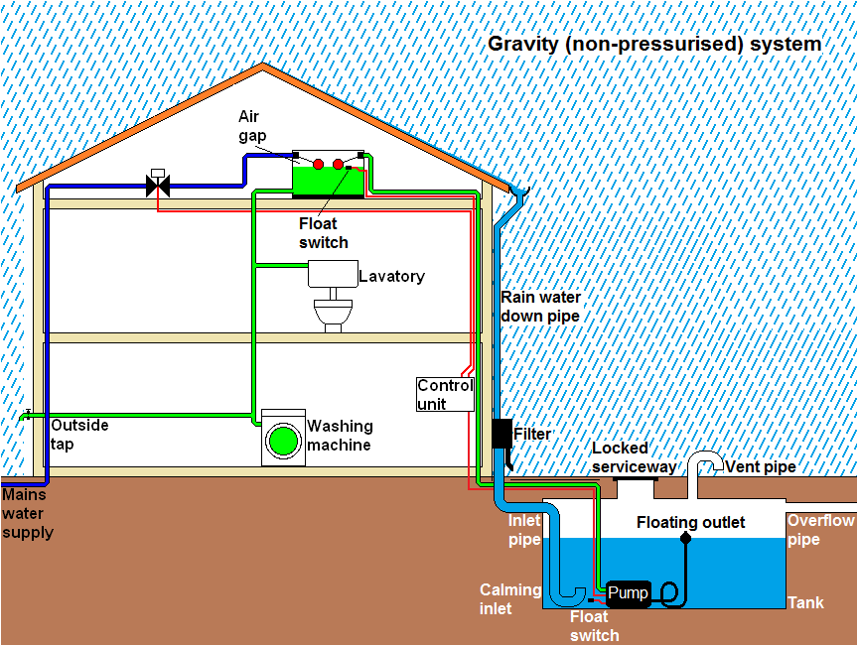
Rainwater harvesting

Slide 8
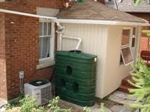
Installation location
The biggest consideration is the location of the storage tank. This can be on the surface like the one in the picture right but it will need protection against freezing in winter.
However, it is much better to have a buried tank as this keeps the water cool and dark and greatly reduces the likelihood of the build‑up of algae in the water.
However, this means that sufficient garden space is required and fairly extensive excavations must be carried out. Once the tank and associated pipe work has been installed and buried only the lockable serviceway will be visible.

Slide 9
Installation location
Inside the premises a new loft storage tank additional to any others must be installed. Also new pipe work from this loft tank to equipment using the rainwater must be installed. This pipe work must be kept completely separate from that feeding other equipment, for example the cold taps of bath, basins and sinks.
All pipe work must distinguish clearly between mains and rainwater.
It will be necessary to install wiring linking the control unit to the pump, float switches and zone valve.

Slide 10
Planning permission
The installation of a RWH system does not in principle need planning permission.
In fact, in gaining planning permission for a new-build or major renovation project, the inclusion of rainwater harvesting in the project can help towards approval.
Rainwater harvesting ticks two boxes for planners.
Not only is rainwater harvesting seen as a means to save on mains water consumption, but also, and often nowadays, of more importance to planners, as a way of alleviating flood threats.

Slide 11
Building Regulations
In 2010, a change in the Building Regulations has reinforced official support for rainwater harvesting. Building Regulations Part G (April 2010) makes 125 litres per person per day of mains water consumption the maximum.
The underground tank should not be installed any closer to a house than a line drawn at a 45-degree angle from the base of the house. It usually works out that the closest part of the tank should not be closer to the building than the overall height of the tank.
Building regulations also apply to other aspects of the work such as electrical installation and plumbing work.

Slide 12
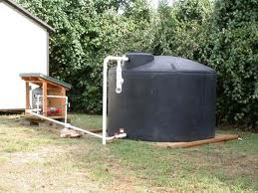
Advantages of rainwater harvesting
Saves money by reducing water usage.
A volume of water is kept out of the storm‑water management system, thereby helping to reduce flooding risks.
Gains eco-homes rating points for your property.
Rainwater is better for your garden as it has a balanced pH and is free of chemicals such as chlorine.
In its agricultural application rainwater harvesting has also been used to provide drinking water for livestock and irrigating crops.

Slide 13
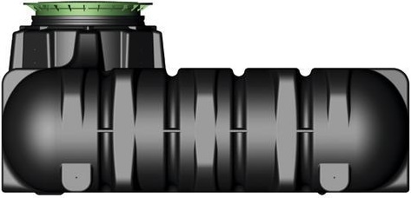
Disadvantages of rainwater harvesting
High cost when retro fitting to an existing property.
Requires some maintenance to filtration.
Requires separate pipe work to be installed.
Unpredictable rainfall.
Vulnerable water quality.

Slide 14
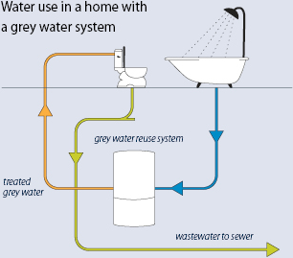
Greywater re-use
Greywater, or sullage, is wastewater generated from domestic activities such as laundry, dishwashing, and bathing, which can be recycled on-site for uses such as landscape irrigation and constructed wetlands.
Greywater differs from water from the toilets which is designated sewage or blackwater to indicate it contains human waste.
Most greywater is easier to treat and recycle than blackwater, because of lower levels of contaminants.

Slide 15
Greywater re-use
If collected using a separate plumbing system from blackwater, domestic greywater can be recycled directly within the home, garden or company and used either immediately or processed and stored.
If stored, it must be used within a very short time or it will begin to putrefy due to the organic solids in the water.

Slide 16
Greywater re-use
Recycled greywater of this kind is never safe to drink, but a number of stages of filtration and microbial digestion can be used to provide water for washing or flushing toilets.
Greywater reuse systems vary significantly in their complexity and size from small systems with very simple treatment to large systems with complex treatment processes.

Slide 17
Greywater re-use
However, most have common features such as:
a tank for storing the treated water
a pump
a distribution system for transporting the treated water to where it is needed; and
some sort of treatment.

Slide 18
Installation considerations
Storage tanks and pipe work
The location of collection, treatment and holding tanks.
Greywater system tanks need to be sized to provide a balance between supply and demand whilst maintaining a reasonable throughput.
All pipe work carrying treated greywater must be clearly marked as a non-potable greywater supply.

Slide 19
Installation considerations
Pumps and treatment
Greywater is normally collected at a low level and then pumped to where it can refill toilet cisterns.
Where greywater is used inside the home, biological treatment and disinfection will be required to control bacterial growth and provide ‘clear’ water.
For other uses the degree of treatment will vary depending on the quality of water needed.

Slide 20
Installation considerations
Maintenance
An alternative non-potable water supply is not a 'fit and forget' technology.
Regular cleaning and maintenance and removal of debris from filters and from the biological treatment process are needed.
Regular visual inspection of the system components and replacement of filters according to manufacturer's recommendations is required.
Ensure mains water top-up is functioning and protected from contamination. Regular checks on greywater disinfection in accordance with manufacturer's recommendations.

Slide 21
Regulations
All installations must comply with the Water Supply (Water Fittings) Regulations 1999 in England and Wales.
The Building Regulations Parts G and H apply.
British Standards BS8525‑1:2010 Greywater Systems Code of Practice covers the design, installation and maintenance of these systems.

Slide 22
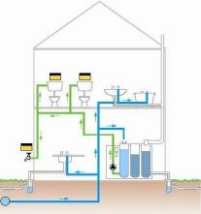
Advantages of greywater re-use
Conserves wholesome water.
Indirectly reduces energy consumption and reduces carbon emissions.
A wide range of system options exist.
Greywater is free, so for buildings where a water meter is fitted the annual cost of water will be reduced.

Slide 23
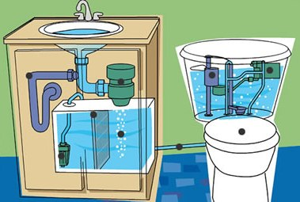
Disadvantages of greywater re-use
Payback periods can be long.
Not always straightforward to install in an existing building.
There is a risk of contamination or cross-connection.
Only certain types of outlet and appliance can be supplied using greywater.

Slide 24
Any questions?

